Slide 1

ניהול מבחנים פרויקט סוף סדנה C#.net
Tomer ramon
204621510

Slide 2
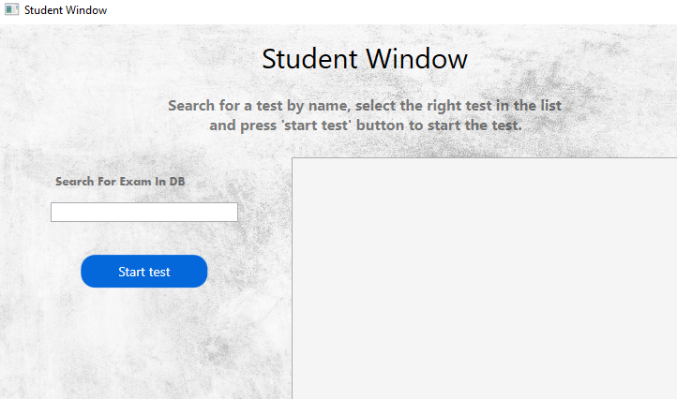
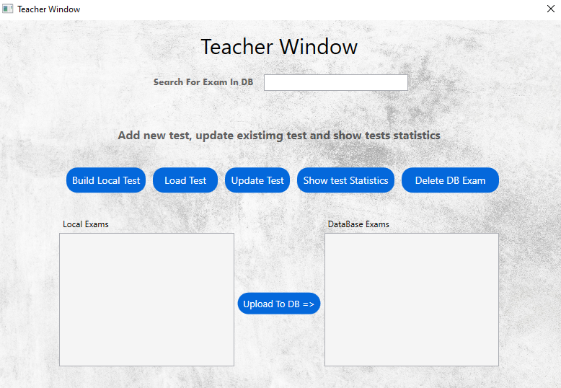
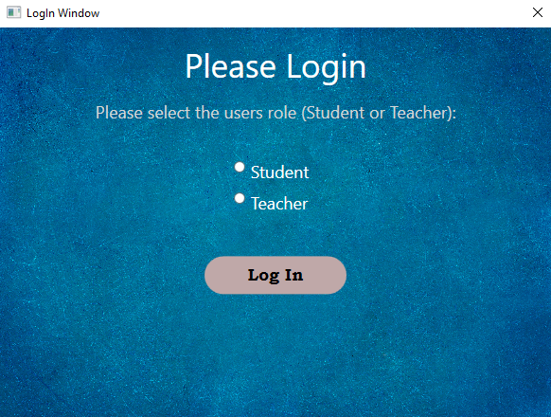
This project is about managing a test interface for both teachers and students.
For each of the users, the application provides different options with the help of different management screens.
For a teacher, he has the options of creating, saving, editing, updating and deleting tests within a database.
In addition, he has the option to see statistical data for the test he has chosen.
Student can search and solve an exam.

Slide 3
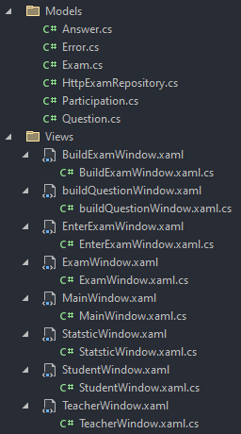
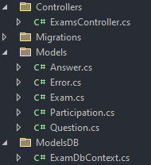
General structure
Client Side:
Models:
Exam.cs
Question.cs
Participation.cs
Answer.cs
Error.cs
Repositories:
HttpExamRepository.cs
Views:
BuildExamWindow.xaml.cs
buildQuestionWindow.xaml.cs
EnterExamWindow.xaml.cs
ExamWindow.xaml.cs
MainWindow.xaml.cs
StatsticWindow.xaml.cs
StudentWindow.xaml.cs
TeacherWindow.xaml.cs
Server Side:
Models:
Exam.cs
Question.cs
Participation.cs
Answer.cs
Error.cs
ModelsDB:
ExamDbContext.cs
Controllers:
ExamController.cs

Slide 4
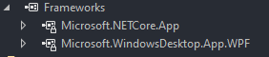
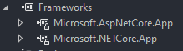
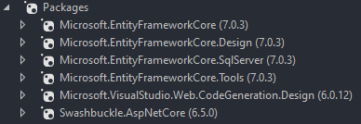
Frameworks & nuget technologies
Telhai. CS.Final.Client:
For the client side I used the following Frameworks as required of us:
Telhai.CS.Final.Server:
In the server side, frameworks alone wasn’t enough and in addition I used some nuget packages for accessing and working with a database

Slide 5
List of screens on the client side
BuildExamWindow.xaml
buildQuestionWindow.xaml
EnterExamWindow.xaml
ExamWindow.xaml
MainWindow.xaml
StatsticWindow.xaml
StudentWindow.xaml
TeacherWindow.xaml

Slide 6
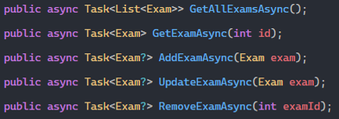
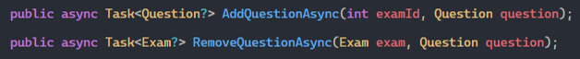
List of API functions for accessing server
HttpExamRepository.cs functions: Exam functions:
Question function:
Participation function:

Slide 7
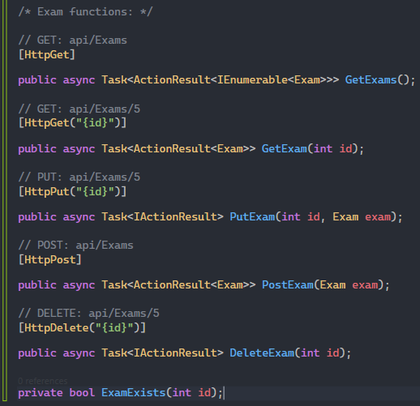
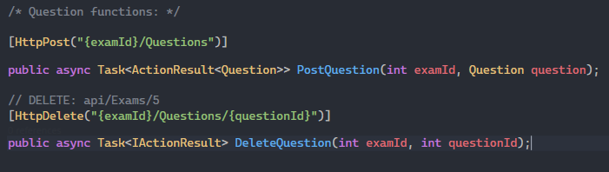
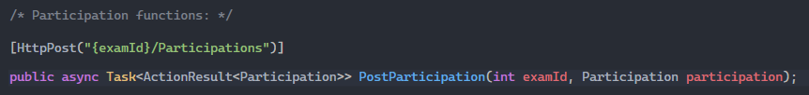
List of API functions for accessing server
ExamController.cs functions:

Slide 8
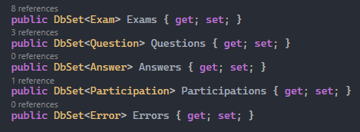
Tables definitions in the ExamContext
In addition to these definitions, there is also the definition of the relationships between the tables:
one Exam has -many Questions.
one Question has - many Answers.
one Exam has - many Participations.
one Participation has – many Errors.

Slide 9
.Json files:
For the exam files that are saved locally as a .Json files, there is a dedicated folder in the project folder, the path to the folder is:
\Final Project\Telhai.CS.Final.Client\bin\Debug\net6.0-windows\Local_Exams
The role of this folder is to save the new tests that are created before they are sent to the server (DB), in addition this is the folder where the tests are saved when you click the save button on the build exam screen.
When the teachers window is loaded, the “loadexams()” function is activated from “HttpExamRepository.cs”, which accesses the folder, reads all the JSON files (if any), serialize them to be exam files, and finally sends them to be displayed in the listbox of local exams in the window.

Slide 10
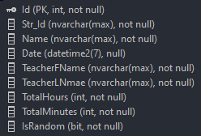
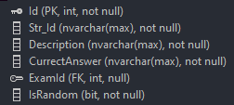
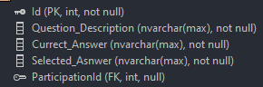
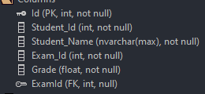
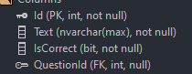

Tables and columns in the database
exam
Question
Error
Participation
Answer

Slide 11
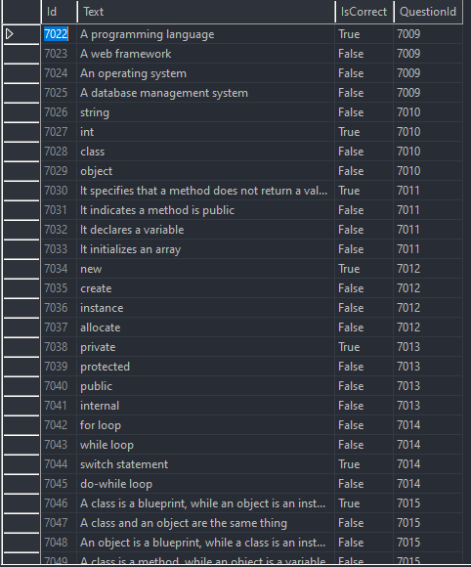
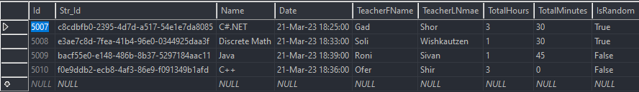
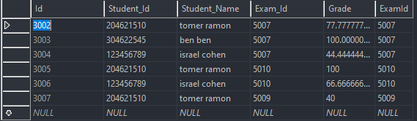
Tables and columns in the database – screenshots
Answers:
Exams:
Participations:

Slide 12
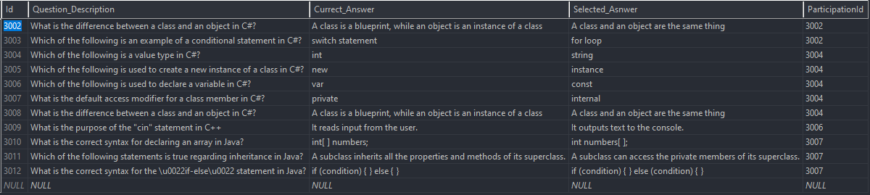
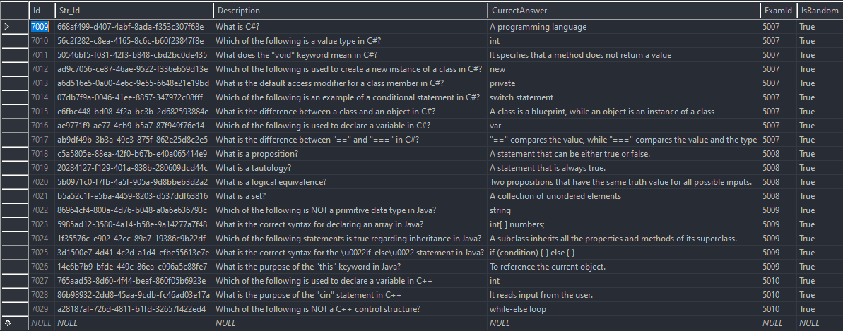
Errors:
Questions:

Slide 13
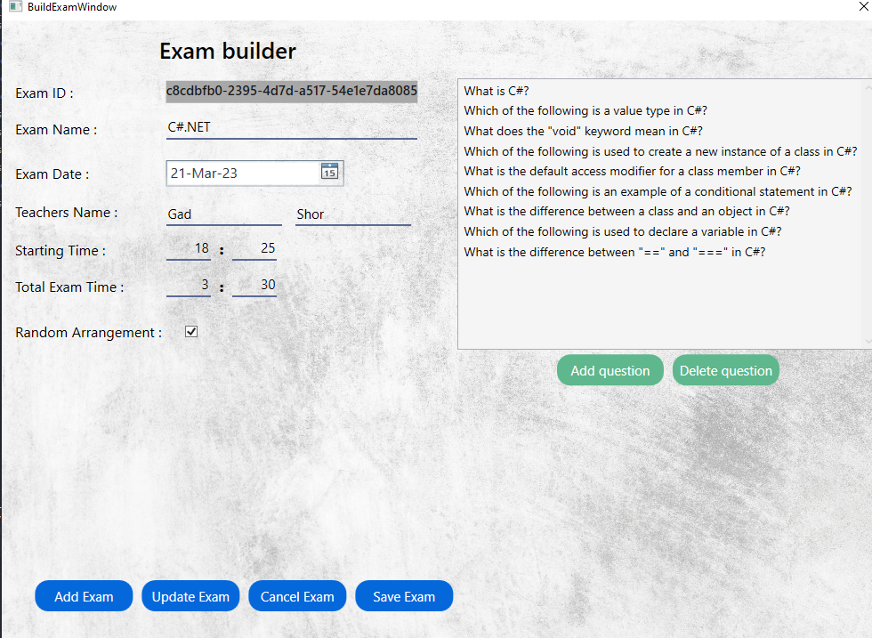
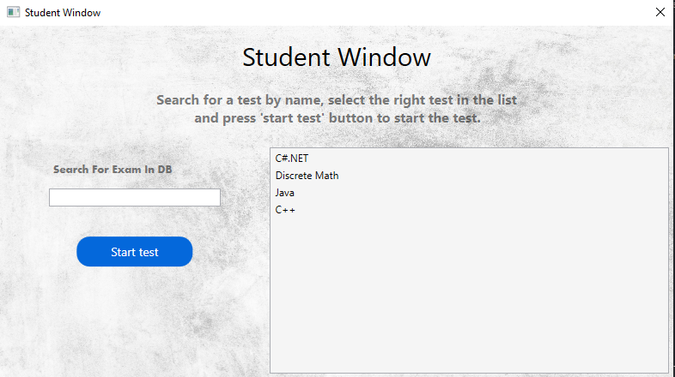
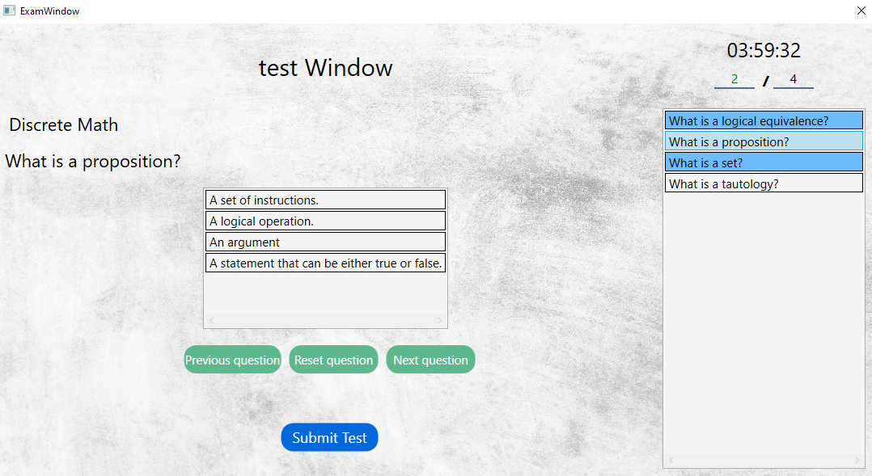
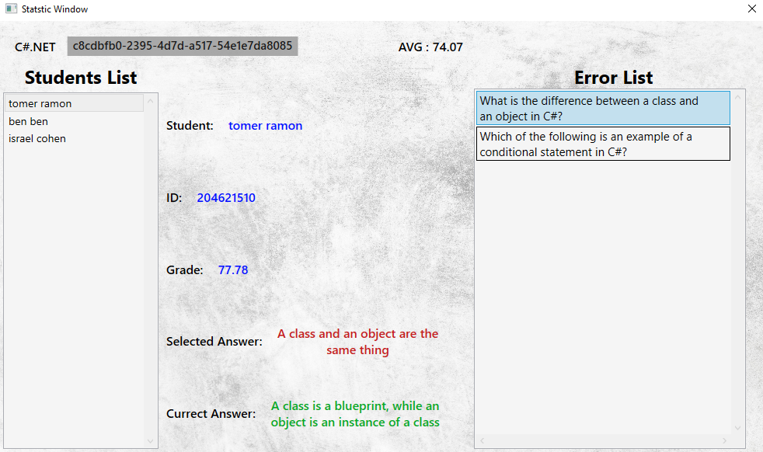
Few Windows screenshots

Slide 14
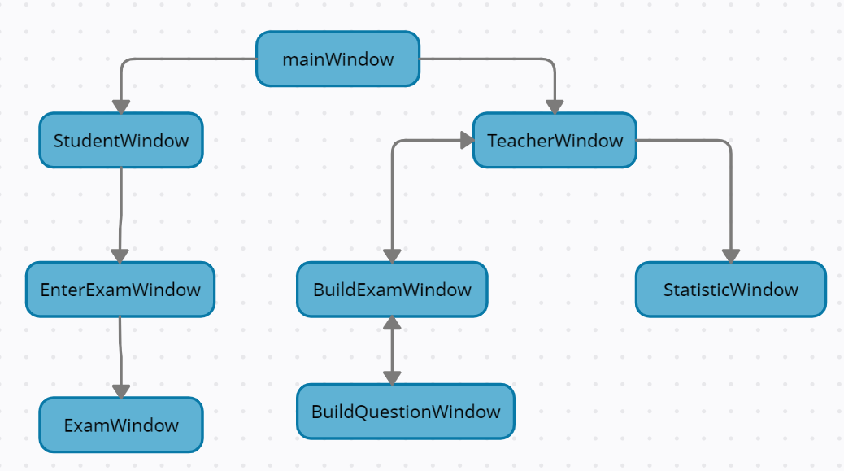
General Data flow

Slide 15
THANK YOU

